Slide 1
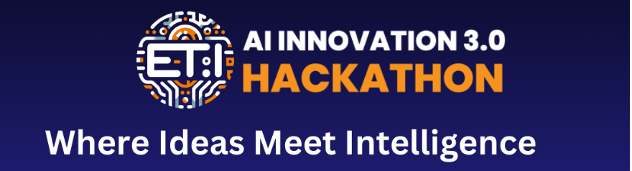
DOCBOT: Your Intelligent Document Assistant
Enhancing Document Understanding with YOLO, OCR and Langchain
Group Number - B-38A

Slide 2
Introduction
Introduction to our project focused on developing a Document Bot (Doc Bot) capable of extracting both text and images from PDF documents.
The pipeline involves various components aimed at efficiently ingesting and processing data from PDF files.
Key highlights include the integration of OCR (Optical Character Recognition) for text extraction and the utilization of the YOLO (You Only Look Once) model for image extraction.
The subsequent steps in the pipeline will be discussed in detail throughout the presentation.

Slide 3
OCR (Optical Character Recognition)
Concept Explanation:
OCR (Optical Character Recognition) is a technology used to convert various types of documents, such as scanned paper documents, PDF files, or images captured by a digital camera, into editable and searchable data.
In our project, we employed the pytesseract library for OCR to extract text from images.
Drawback:
While OCR is effective in extracting text from most documents, it faces limitations when dealing with images that are not well-structured or inaccessible due to formatting issues.
Certain images within PDF files may not be recognized accurately or may not be accessible through traditional OCR methods.
Transition:
To overcome these challenges and ensure comprehensive data extraction, we implemented a new approach using the YOLO (You Only Look Once) model, which we will discuss in the next slide.

Slide 4
YOLO Model for Image Extraction
Concept Explanation:
YOLO (You Only Look Once) is an object detection system that can detect objects in real-time with high accuracy.
It operates by dividing the image into a grid and predicting bounding boxes and probabilities for each grid cell simultaneously.
Implementation:
We trained a custom YOLO model tailored to detect images and tables within PDF documents.
This custom model addresses limitations of traditional OCR methods in handling complex document structures.
By leveraging the YOLO model, we achieve enhanced accuracy and efficiency in image extraction.
Transition:
The integration of the YOLO model enhances our data ingestion and processing pipeline, enabling precise extraction of both textual and visual information from PDF documents.

Slide 5
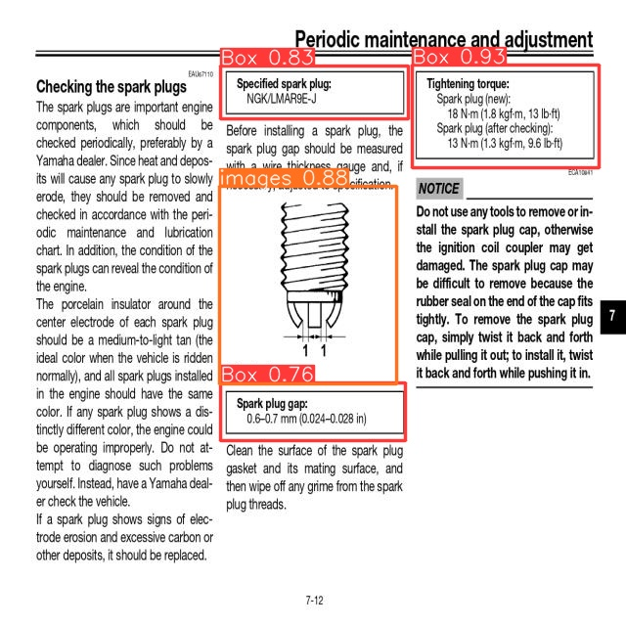
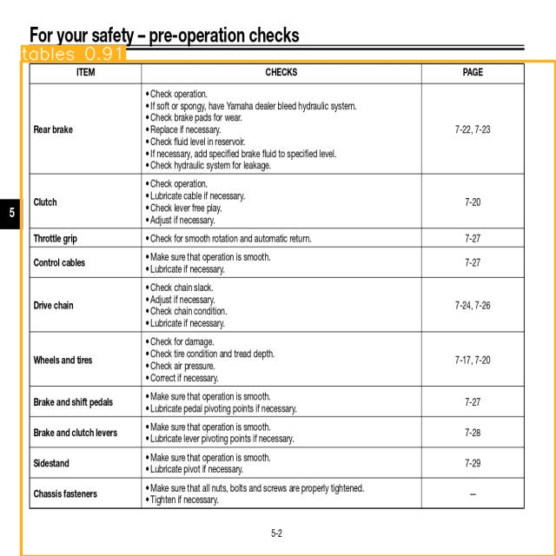
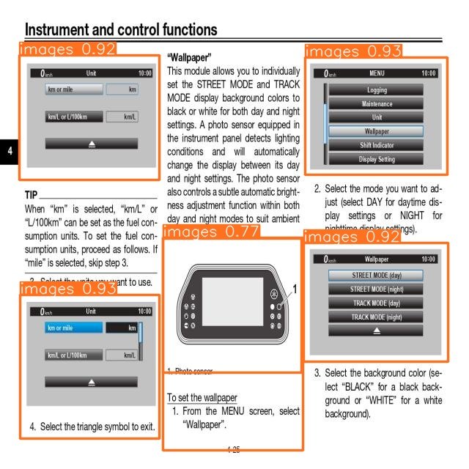
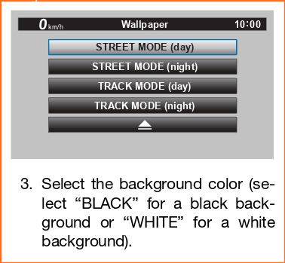
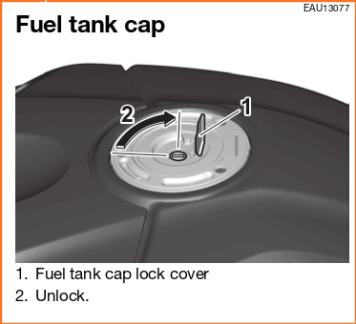
YOLO Outputs

Slide 6
Data Ingestion
Implementation:
Utilized React to create a user-friendly interface for data ingestion.
Users upload PDF files directly on the site for processing.
Workflow:
Uploaded PDFs are processed to extract text and image information.
Users can input questions on the same site page.
User Interaction:
Seamless interaction with document content within the site.
Questions are answered directly on the same page.
Benefits:
Simplified user experience with a single platform for upload and interaction.
Efficient access to document insights without navigating away from the site.
Transition:
This streamlined approach to data ingestion ensures user convenience and efficient interaction with document content.

Slide 7
Image Information Extraction
Overview:
This slide explains the process of extracting information from images using OCR and the YOLO model.
Steps:
Text extraction from images is performed using the easyocr library.
The YOLO model is used to detect images within PDF pages.
A dictionary is created to organize the extracted image information.
Importance:
Accurate image information extraction is crucial for data analysis and understanding, making OCR and YOLO valuable tools in the pipeline.

Slide 8
Language Model Pipeline
Overview:
This slide describes the language model pipeline utilized for text generation and question answering.
Components:
The Hugging Face's text2text-generation pipeline is introduced for text generation tasks.
RetrievalQA is integrated for question answering using pre-trained language models.
Functionality:
The pipeline's capabilities in generating responses and answering questions based on input instructions are discussed.

Slide 9
Conclusion
Our model has demonstrated robust performance in extracting both text and images from PDF documents, contributing to the development of an efficient Document Bot (Doc Bot).
Through the integration of OCR and the YOLO model, we have achieved accurate and reliable extraction of textual and visual information, respectively.
The data ingestion and processing pipeline presented here showcases the effectiveness of combining advanced technologies to tackle complex document processing tasks.
We have successfully addressed challenges related to OCR accuracy, image detection, and data organization, resulting in a streamlined and comprehensive solution for document analysis.

